Slide 1
Azure Functions Introduction
T.B.D.

Slide 2
A Lap Around Azure Functions
March 24th, 2017
Michael S. Collier

Slide 3
Michael S. Collier
Senior Software Development Engineer,
DX TED – Global Commercial ISV
michael.collier@microsoft.com
@MichaelCollier
www.MichaelSCollier.com

Slide 4
Central Ohio Azure User Group
coazure.org
@coazureug
meetup.com/Central-Ohio-Azure

Slide 5
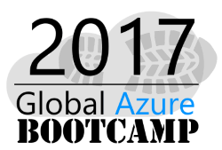
April 22, 2017 8:00AM – 4:00PM
A full day of Azure learning targeted at both new and experienced Azure users
Free to all attendees!
Presentations & Labs include Dev Ops, Azure Container Service, IoT and Bots & Cognitive Service
Register today at http://bit.ly/cols-gab
Microsoft
8800 Lyra Dr., Suite 400
Columbus, OH

Slide 6
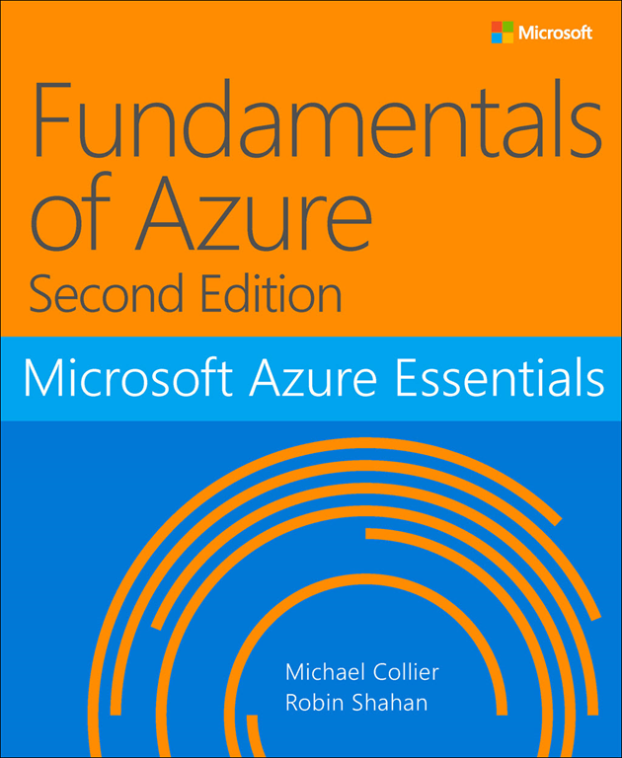
http://aka.ms/FundAzure2e

Slide 7
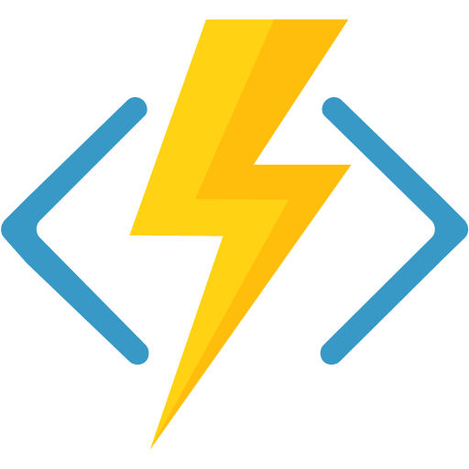
Agenda
Why Serverless?
What is serverless?
Intro Azure Functions
Demos and more demos

Slide 8
Why Serverless

Slide 9
Before cloud
On-Premises
Co-Lo
Notes:
It’s all you - your hardware, your VMs, your application servers, etc.

Slide 10
Before cloud
What happens in case of
server hardware failure?
What is the right size of
servers for my business needs?
Which packages should
be on my server?
How I scale my app?
How can I increase server utilization?
What media should I
use to keep backup?
How I deploy new code to my server?
Who monitors
my Servers?
Who monitors
my App?
How often should I backup
my server?
What storage I need to use?
What size of servers
should I buy?
Who has physical
access to my servers?
Are my server in a
secure location?
Do I need secondary
network connection?
Which OS should I use?
How many servers
do I need?
What happens if the
power goes out?
How can I dynamically
configure my app?
Do I need a UPS?
It takes how long to provision a new server?
How often should
I patch my servers?
Notes:
It’s all you - your hardware, your VMs, your application servers, etc.

Slide 11
Then came IaaS …
What happens in case of
server hardware failure?
What is the right size of
servers for my business needs?
Which packages should
be on my server?
How I scale my app?
How can I increase server utilization?
What media should I
use to keep backup?
How I deploy new code to my server?
Who monitors
my Servers?
Who monitors
my App?
How often should I backup
my server?
What storage I need to use?
What size of servers
should I buy?
Who has physical
access to my servers?
Are my server in a
secure location?
Do I need secondary
network connection?
Which OS should I use?
How many servers
do I need?
What happens if the
power goes out?
How can I dynamically
configure my app?
Do I need a UPS?
It takes how long to provision a new server?
How often should
I patch my servers?
Notes:
IaaS removed some of the burden . . .but still had several things to think about.

Slide 12
Is it PaaS time?
What is the right size of
servers for my business needs?
Which packages should
be on my server?
How I scale my app?
How can I increase server utilization?
How I deploy new code to my server?
Who monitors
my App?
How often should I backup
my server?
Which OS should I use?
How many servers
do I need?
How can I dynamically
configure my app?
How often should
I patch my servers?
Notes:
PaaS removed even more of the burden . . . But still things to worry about outside of just the app and your business.

Slide 13
Is it PaaS time?
What is the right size of
servers for my business needs?
Which packages should
be on my server?
How I scale my app?
How can I increase server utilization?
How I deploy new code to my server?
Who monitors
my App?
How often should I backup
my server?
Which OS should I use?
How many servers
do I need?
How can I dynamically
configure my app?
How often should
I patch my servers?
Notes:
PaaS removed even more of the burden . . . But still things to worry about outside of just the app and your business.

Slide 14
Serverless . . .
What is the right size of
servers for my business needs?
How I architect my app
to become serverless
How I scale my app?
How can I increase server utilization?
How many servers
do I need?
Notes:
Serverless removes much of the baggage of IaaS and PaaS . . You focus on SOLUTION architecture.

Slide 15
What is Serverless

Slide 16
What is Serverless?
Abstraction of servers
Event-driven/ instant scale
Sub-second billing
Notes:
Serverless compute is a fully managed service. Some refer to it as Functions as a Service
OS and Framework patching is performed for you
There is zero administrative tasks and no need to manage any infrastructure
You just deploy your code (function) and it runs
Your code runs within seconds and for very short period of time
Serverless compute scales quickly (almost instantly) and vastly
Automatically scales within seconds
No scale configuration is required (there is no way to configure scale or limits)
Scales to match any given workload. Scales from zero to handle tens of thousands concurrent functions invocations within seconds
Pay only for the time your code is running
Serverless compute reacts to events
React, in near real-time, to events and triggers
Triggered by virtually any event from Azure service or 3rd party services

Slide 17
Benefits of Serverless?
Focus on Business Logic
Reduced Time To Market
Reduced DevOps
Notes:
“Pinnacle of PaaS compute”
Not just hardware “servers”, but software servers are also managed for you
Focus on business logic, not solving technical problems not core to business
Lower effort to get started makes it easier to experiment (bots, etc.)
Benefits of “serverless”

Slide 18
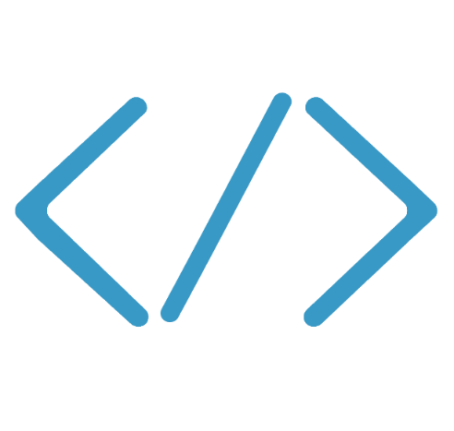
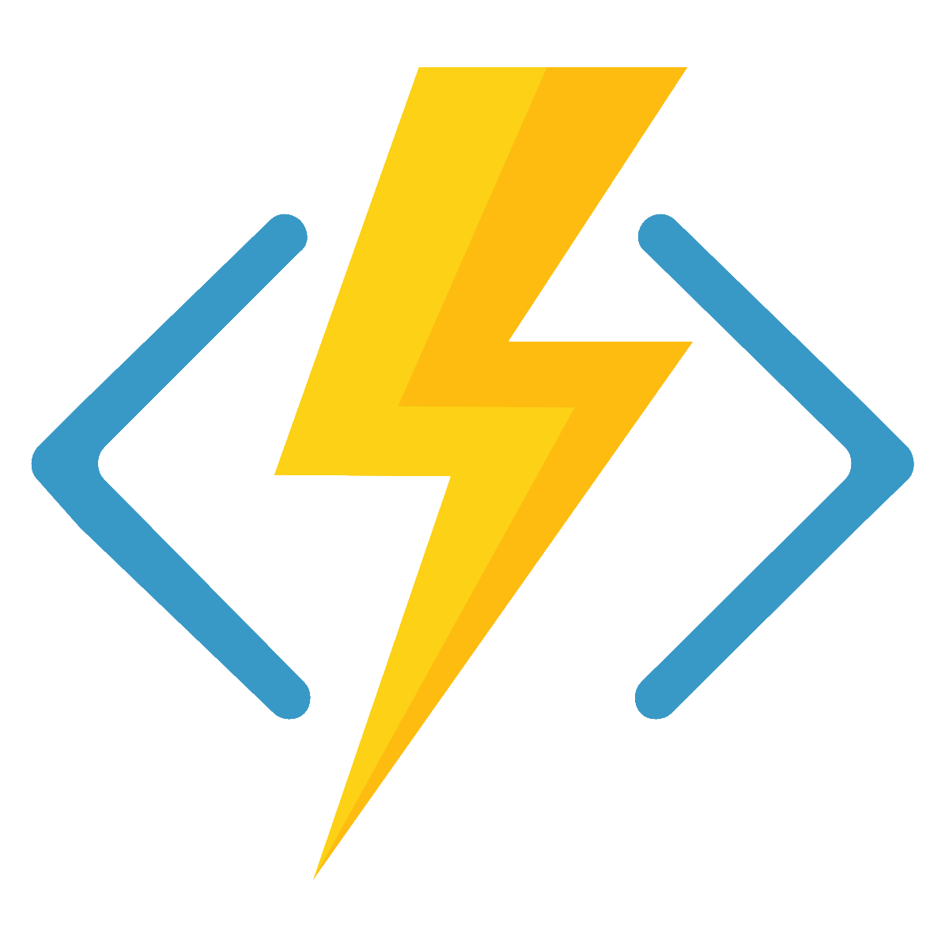

Azure Functions
Code
Azure Functions
Events + data
Process events with Serverless code.
BAM!!!
Make composing Cloud Apps insanely easy
Develop Functions in C#, Node.js, F#, Python, PHP, Batch and more
Easily schedule event-driven tasks across services
Expose Functions as HTTP API endpoints
Scale Functions based on customer demand
Easily integrate with Logic Apps
Notes:
Azure Functions is a serverless event driven compute that extends the existing Azure App Service platform.

Slide 19
Functions Hello World
Demo
Notes:
Demo - Hello World
create simple http trigger
show all other triggers

Slide 20
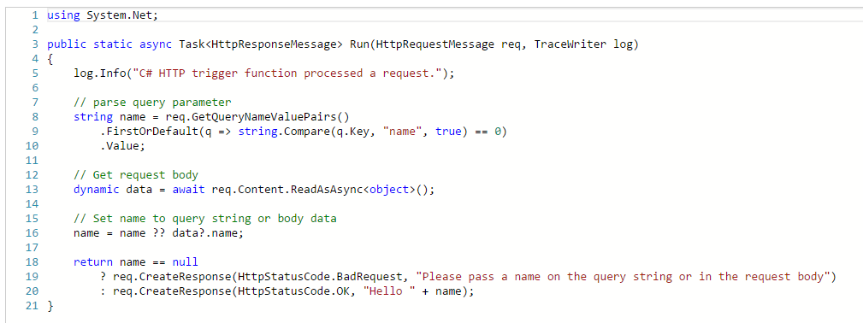
Azure Functions Programming Model
Trigger & Inputs
The Code
Outputs
Notes:
Most folks that get started with Azure Functions first start from the Azure Portal where we have a variety of features to help you get started quickly.

Slide 21
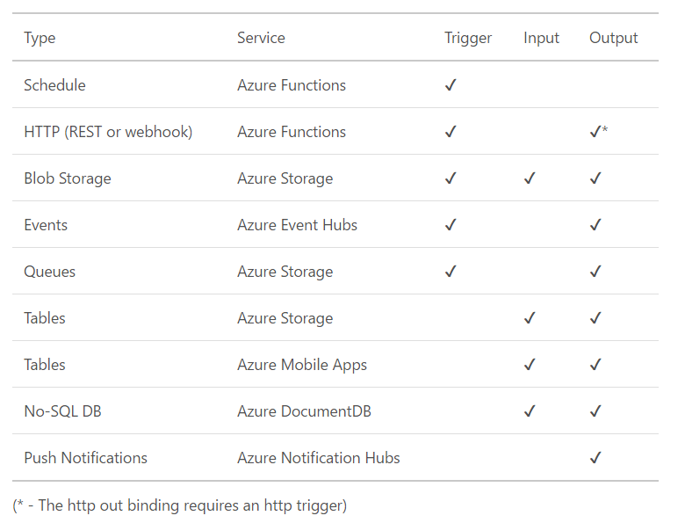
Triggers and bindings
Notes:
https://azure.microsoft.com/en-us/documentation/articles/functions-triggers-bindings/
We will show in the next demo that the portal has more binding and more granular per service

Slide 22
Functions Programming Model - Best Practices
Functions should “do one thing”
Functions should finish as quickly as possible (< 5 min.)
Functions should be stateless
Functions should be idempotent
Queues for cross function communication
1
See https://docs.microsoft.com/en-us/azure/azure-functions/functions-best-practices for more.
Notes:
https://docs.microsoft.com/en-us/azure/azure-functions/functions-best-practices

Slide 23
GitHub WebHooks
Do something if there is an issue comment
Notes:
https://github.com/mcollier/ballin-ninja/settings/hooks/12798358

Slide 24
Timer Trigger
Alert me if I need to wear a jacket today

Slide 25
Fun with Twilio
Send a text message to
555-555-5555
Notes:
Echo Response

Slide 26
Save to DocumentDB
Save current weather observation to DocumentDB
Notes:
Echo Response

Slide 27
Infrastructure as Code & Continuous Deploy
Demo
Notes:
Twitter -> Logic App -> Function -> DocumentDB

Slide 28






Apps
eCommerce
Digital Global Presence
Custom Apps
LOB
API / Services / ISV
App Service
Web Apps
Mobile Apps
API Apps
Functions
Fully Managed Platform
Development
Enterprise Grade
Limitless/Auto
OS and Framework
Load balance
Something else
Languages and Framework
Superior DevOps
Self served
Something else
Enterprise grade SLA
Secure and Compliance
On-Premise Connectivity
Something else

Slide 29







Azure Functions
Serverless
Accelerate development
Bind into services
Azure Service Bus
Azure Event Hub
Azure Storage
</>
Dropbox
Sendgrid
AzureDocDb
Event-driven scale
Reduced Dev Ops
Develop your way
Local development
OneDrive
Box
Twilio
Notes:
Azure Functions is a Serverless, event driven compute that allows you to:
* Make composing Cloud Apps insanely easy
Develop Functions in C#, Node.js, F#, Python, PHP, Batch and more
Focus on Business Logic, not infra problems
* Easily schedule event-driven tasks across services
* Expose Functions as HTTP API endpoints
* Scale Functions based on customer demand
* Easily integrate with Logic Apps

Slide 30
Microsoft and Serverless
Try Functions – https://functions.azure.com
Try App Service – https://tryappservice.azure.com

Slide 31
Resources
Azure Functions
https://docs.microsoft.com/en-us/azure/azure-functions/
https://azure.microsoft.com/en-us/pricing/details/functions/
Rename a Function
https://github.com/projectkudu/AzureFunctionsPortal/issues/198
Publish .NET Class Library as Function App
https://blogs.msdn.microsoft.com/appserviceteam/2017/03/16/publishing-a-net-class-library-as-a-function-app/
All My Demos & Presentation
https://github.com/mcollier/fun-functions-demo

Slide 32
Questions?

Slide 33
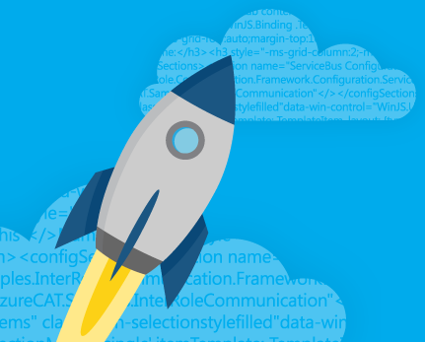
Thank You!
Michael S. Collier
@MichaelCollier | www.michaelscollier.com
michael.collier@microsoft.com

